Slide 1
Conftool calendar / programme and export to outlook
Prof. Dr. Rudolf R. Sinkovics rudolf.sinkovics@glasgow.ac.uk
www.sinkovics.com/rudolf www.linkedin.com/in/rudolfsinkovics
@RudolfSinkovics
Notes:
File history:
Template colors:
Primary colours
University Blue: R0 G56 B101 / #003865
Burgundy: R125 G34 B57 / #7D2239
Cobalt: R0 G117 B176 / #005C8A
Lavender: R91 G77 B148 / #5B4D94
Leaf: R0 G132 B61 / #006630
Moss: R56 G90 B79 / #385A4F
Pillarbox: R179 G12 B0 / #B30C00
Rust: R190 G77 B0 / #9A3A06
Sandstone: R122 G104 B85 / #52473B
Sky Blue: R0 G83 B152 / #005398
Slate: R79 G89 B97 / #4F5961
Thistle: R149 G18 B114 / #951272
Secondary colours
Turquoise: R0 G181 B209
Rose: R176 G108 B150
Pumpkin: R255 G185 B72
Sunshine: R255 G220 B54
Mocha: R170 G128 B102
Brand elements information UofG
https://www.gla.ac.uk/myglasgow/staff/brandtoolkit/resources/promotionalmaterials/powerpoint/
https://www.gla.ac.uk/myglasgow/staff/brandtoolkit/brandelements/colours/
https://www.gla.ac.uk/myglasgow/staff/brandtoolkit/brandelements/logo/

Slide 2
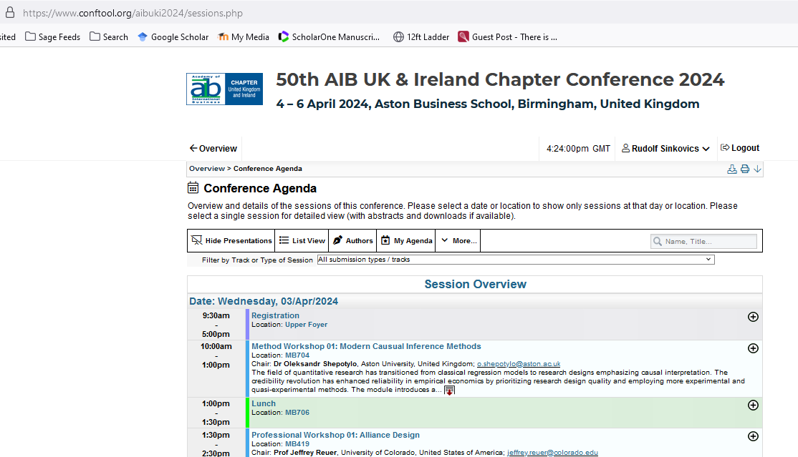
Login at https://www.conftool.org/aibuki2024/ and then look at the programme: https://www.conftool.org/aibuki2024/sessions.php

Slide 3
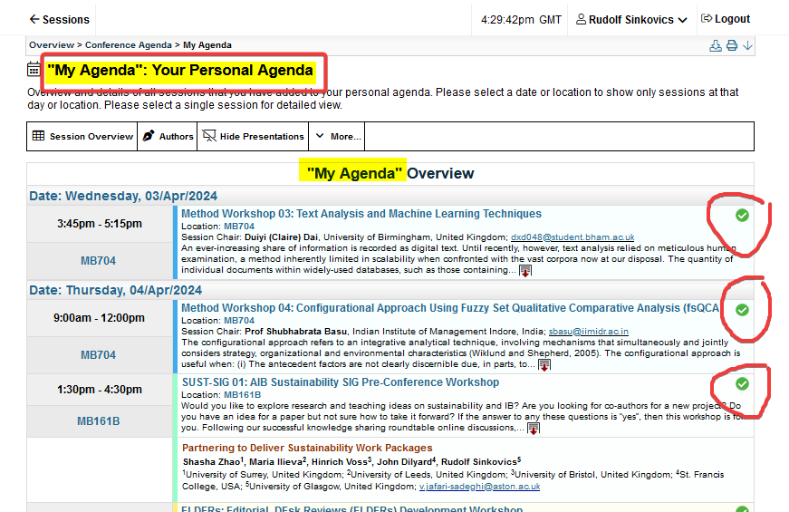
My agenda

Slide 4
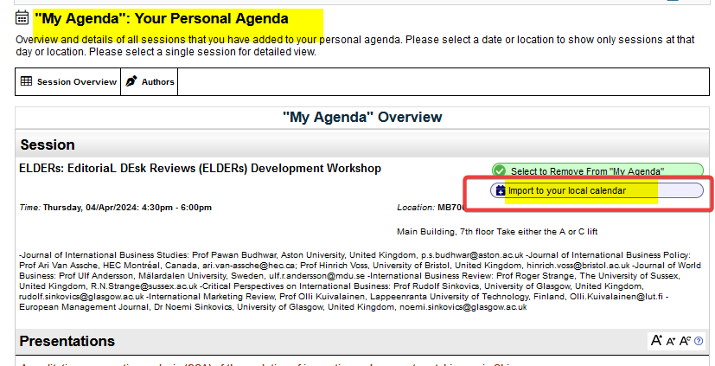
Import “my agenda” to your local Outlook calendar (via .ics calendar file download)…

